Slide 1


Artificial Intelligence
Session 3: Search
School of Computing and Engineering
University of West London, UK
Dr Massoud Zolgharni

Slide 2
What are we up to today?
Problem-solving agents
Problem formulation
Example problems
From a state space graph to a search tree
Basic search algorithms and strategies
Performance of search strategies

Slide 3

Search Problems

Slide 4
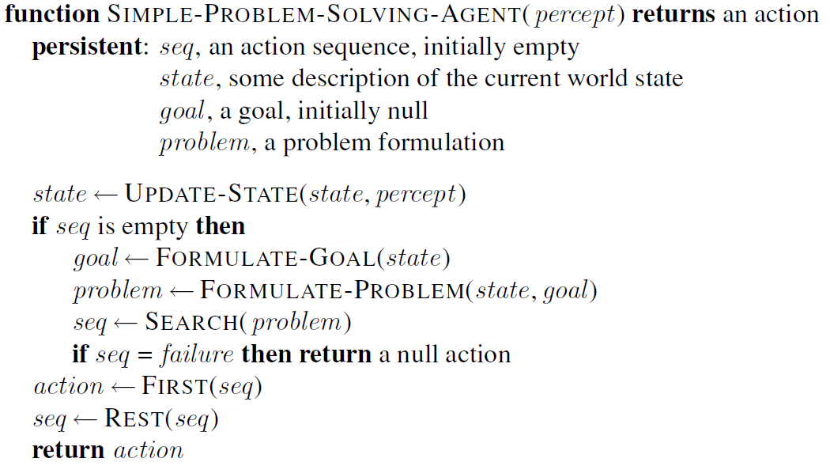
Problem-solving agent
A problem-solving agent:
first formulates a goal and a problem
searches for a sequence of actions that would solve the problem
executes actions one at a time

Slide 5
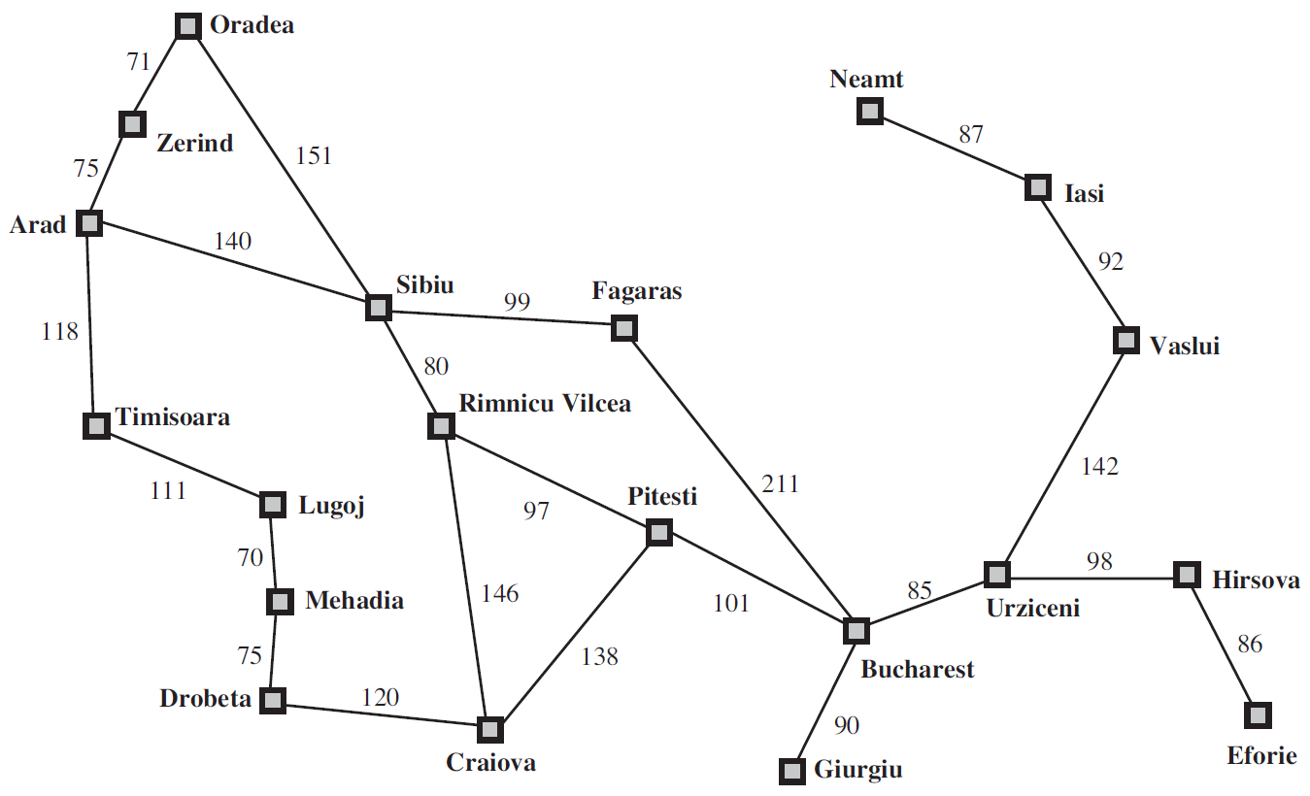
Example Problem: Travelling in Romania
The initial state that the agent starts in.
e.g., initial state for our agent in Romania might be described as In(Arad).

Slide 6
Example Problem: Travelling in Romania
A description of possible actions available to agent.
Given a particular state s, ACTIONS(s) returns set of actions that can be executed in s; each of these actions is applicable in s.
e.g., from state In(Arad), applicable actions are {Go(Sibiu), Go(Timisoara), Go(Zerind)}

Slide 7
Example Problem: Travelling in Romania
Transition model: a description of what each action does; specified by a function RESULT(s, a) that returns state that results from doing action a in state s.
e.g., RESULT(In(Arad),Go(Zerind)) = In(Zerind)

Slide 8
Example Problem: Travelling in Romania
Together, initial state, actions, and transition model define state space of the problem: set of all states reachable from the initial state by any sequence of actions.
The state space forms a directed network or graph in which the nodes are states and the links between nodes are actions.
A path in state space is a sequence of states connected by a sequence of actions.

Slide 9
Example Problem: Travelling in Romania
The goal test, determines whether a given state is a goal state.
e.g., {In(Bucharest)}

Slide 10
Example Problem: Travelling in Romania
A path cost function assigns a numeric cost to each path
we assume cost of a path = sum of costs of individual actions along path
e.g., for agent trying to get to Bucharest, time is of essence; cost of path = its length (km)

Slide 11
Example Problem: Travelling in Romania
A solution to problem is an action sequence that leads from initial state to a goal state.
Solution quality is measured by path cost function: an optimal solution has lowest path cost among all solutions

Slide 12
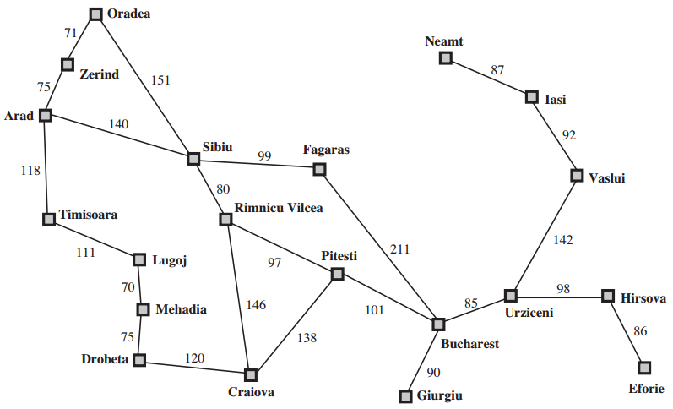
Example Problem: Travelling in Romania
Initial State: “I am in Arrad”
Formulate goal: “I want to be in Bucharest”
Formulate problem:
states: various cities
actions: drive between cities
Find solution:
sequence of cities:
Arad
Sibiu
Fagaras
Bucharest

Slide 13

Example problem: vacuum world
States = state is determined by both agent and dirt locations (agent is in one of 2 locations, each might or might not contain dirt)

Slide 14
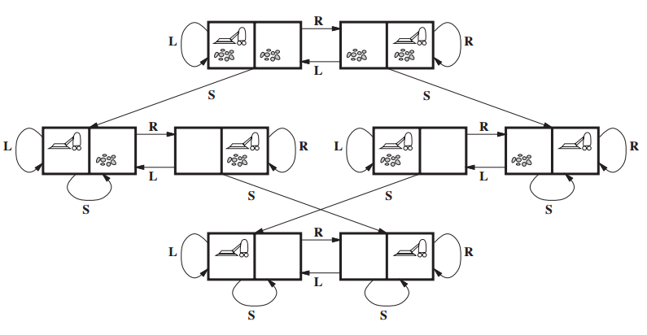
Example problem: vacuum world
States = state is determined by both agent and dirt locations (agent is in one of 2 locations, each might or might not contain dirt → 2 × 2² = 8 possible states)
Initial state = Any state can be designated as initial state
Actions = Left, Right, Suck
Transitional model = Actions have their expected effect (except moving Left in leftmost square, moving Right in rightmost square, and Sucking in a clean room have no effect)
Goal test = No dirt at all locations
Path cost = 1 per action

Slide 15
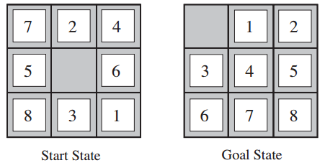
Example problem: 8-Puzzle
States = locations of tiles (Initial state: Any state can be designated as the initial state)
Actions = move blank left, right, up, down
Transitional model = Given a state and Action it returns the resulting space*
Goal test = goal state (given)
Path cost = 1 per move
*: example: if we apply Left to the start state the resulting state have the blank and 5 switched

Slide 16
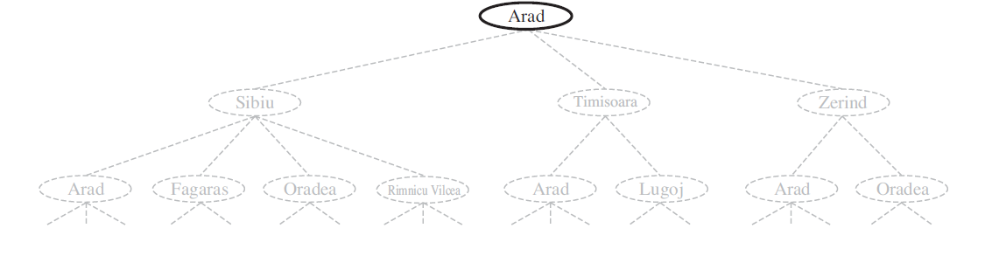
Searching for solutions
Having formulated the problem, we now need to solve it
A solution is an action sequence; search algorithms work by considering various possible action sequences
Possible action sequences starting at initial state form a search tree with initial state at the root; branches are actions and nodes correspond to states in state space of problem

Slide 17
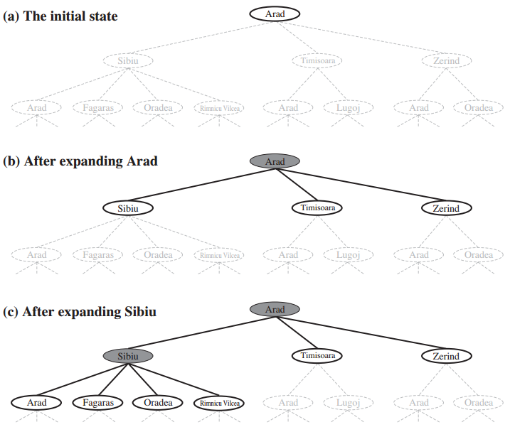
First few steps in growing search tree for finding a route from Arad to Bucharest
= Frontier or Fringe
The set of all leaf nodes available for expansion at any given point is called the frontier
Root node of tree corresponds to initial state, In(Arad).
First step is to test whether this is a goal state.
Then we need to consider taking various actions. We do this by expanding the current state; i.e., applying each legal action to current state → generating a new set of states.
In this case, we add three branches from the parent node In(Arad) leading to three new child nodes: In(Sibiu), In(Timisoara), and In(Zerind).
Now we must choose which of these three possibilities to consider further.
This is the essence of search.

Slide 18
Searching for solutions
Having formulated the problem, we now need to solve it
A solution is an action sequence; search algorithms work by considering various possible action sequences
Possible action sequences starting at initial state form a search tree with initial state at the root; branches are actions and nodes correspond to states in state space of problem
Process of expanding nodes on frontier continues until either a solution is found or there are no more states to expand

Slide 19
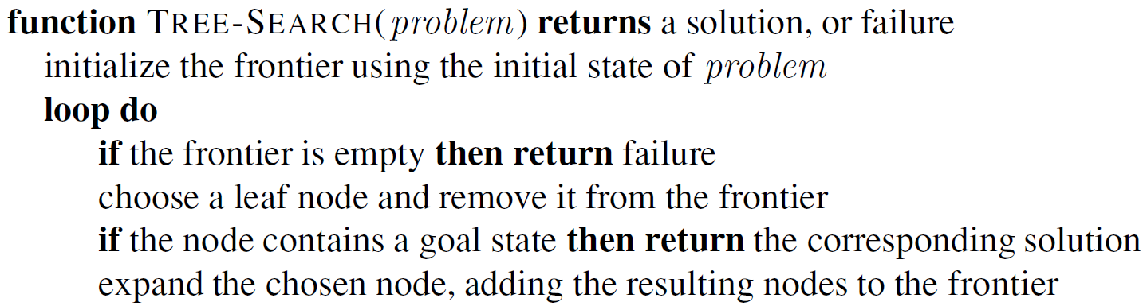
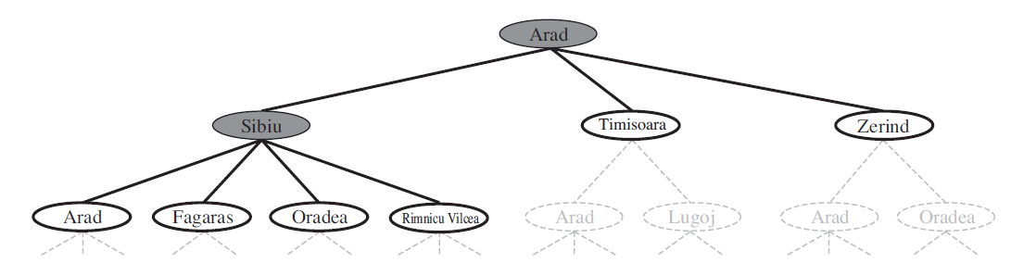
TREE-SEARCH algorithm

Slide 20
TREE-SEARCH algorithm
Search algorithms all share this basic structure; they vary according to how they choose which state to expand next; i.e,. search strategy

Slide 21
Searching for solutions
Search tree includes path from Arad to Sibiu and back to Arad again!
In(Arad) a repeated state in search tree, generated by a loopy path

Slide 22
Searching for solutions
Search tree includes path from Arad to Sibiu and back to Arad again!
In(Arad) a repeated state in search tree, generated by a loopy path
Loopy paths are a special case of more general concept of redundant paths, which exist whenever there is more than one way to get from one state to another
e.g., Arad–Sibiu (140 km) & Arad–Zerind–Oradea–Sibiu (297 km): second path is redundant (just a worse way to get to same state
Redundant paths are unavoidable for problems where actions are reversible; e.g., route-finding problems
To avoid exploring redundant paths, should remember where one has been
Augment Tree-Search algorithm with a data structure called explored set, which remembers every expanded node

Slide 23
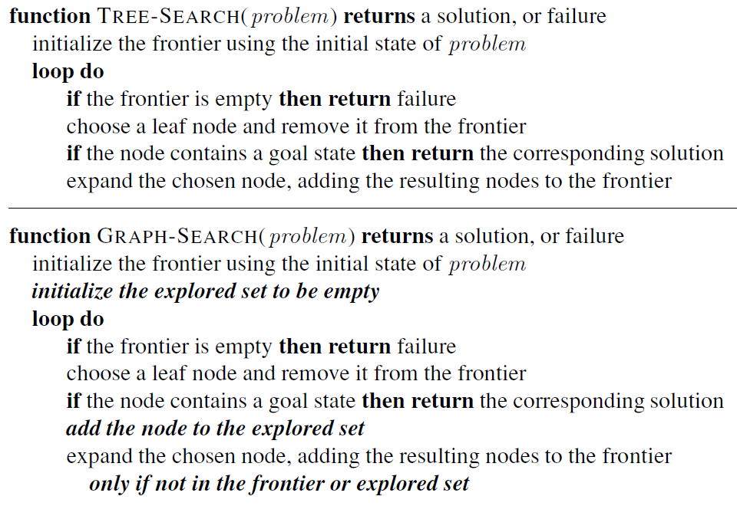
GRAPH-SEARCH algorithm

Slide 24
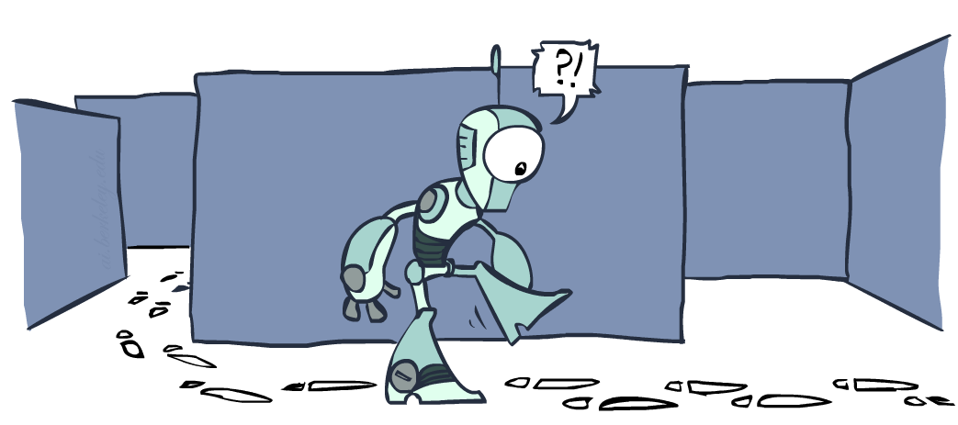
Graph-Search

Slide 25
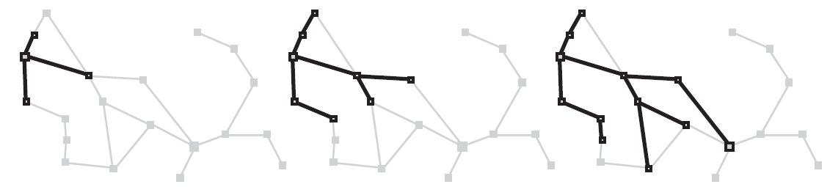
GRAPH-SEARCH algorithm
A sequence of search trees generated by a graph search
At each stage, each path is extended by one step
At 3rd stage, northernmost city (Oradea) has become a dead end: both of its successors are already explored via other paths

Slide 26
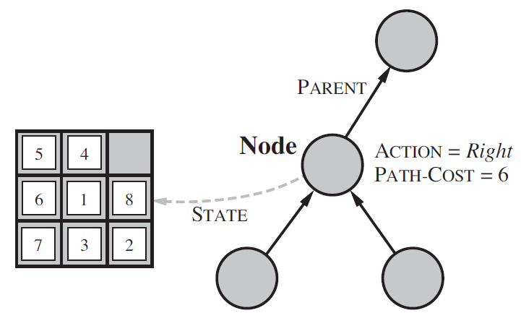
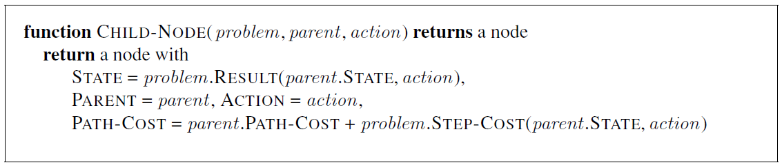
Putting state space graph into a program
Search algorithms require a data structure to keep track of search tree that is being constructed. For each node n of tree, we have a structure that contains 4 components:
n.STATE: a state is represented by a node
n.PARENT: node in search tree that generated this node
n.ACTION: action that was applied to parent to generate node
n.PATH-COST: cost, g(n), of path from initial state to node

Slide 27
Problem-solving performance
A search strategy is defined by picking the order of node expansion
Strategies are evaluated along the following dimensions:
completeness: Does it always find a solution if one exists?
time complexity: The number of nodes generated (how long)
space complexity: The maximum number of nodes in memory (how much)
optimality: Does it always find a least-cost (optimal) solution?
Time and space complexity are measured in terms of
b: branching factor or maximum number of successors of any node
d: depth of least-cost solution (shallowest goal node); (i.e., number of steps along path from root)
m: maximum depth of state space (may be infinite)

Slide 28
Search Strategies: Uninformed search strategies
Uninformed search strategies use only the information available in the problem definition
All they can do is generate successors and distinguish a goal state from a non-goal state)
Breadth-first search
Depth-first search
Depth-limited search
Iterative deepening search
Uniform-cost search

Slide 29
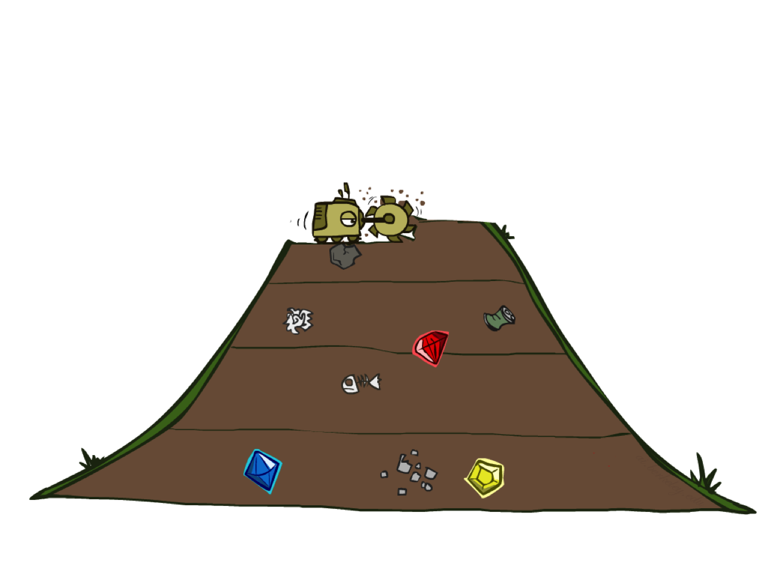
Breadth-first Search (BFS)

Slide 30
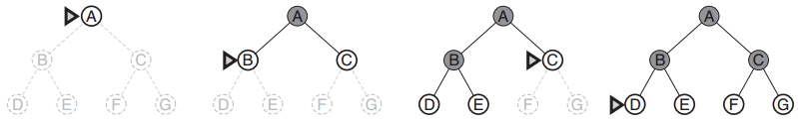
Breadth-first search
root node is expanded first
then all successors of root node are expanded next
then their successors, and so on
In general, all nodes are expanded at a given depth in search tree before any nodes at next level are expanded
Marker indicates the node that is expanded next

Slide 31
Breadth-first search
Expand the shallowest node until you fail or find a solution node
Shallowest = FIFO queue (of the frontier) sorted by depth of nodes
shallower nodes are always selected first (pops oldest element of queue)
new nodes (always deeper than their parents) go to back of the queue

Slide 32
Breadth-first search
Complete = Yes (if b (branching) is finite)
if shallowest goal node is at some finite depth d, breadth-first search will eventually find it after generating all shallower nodes (provided branching factor b is finite)

Slide 33
Breadth-first search
Complete = Yes (if b (branching) is finite)
(Cost)Optimal = Yes (if cost = 1 per step)
Once a goal node is generated, we know it is the shallowest goal node because all shallower nodes must have been generated already and failed the goal test

Slide 34
Breadth-first search
Complete = Yes (if b (branching) is finite)
(Cost)Optimal = Yes (if cost = 1 per step)
Time = O(b^{d})
Imagine searching a uniform tree where every state has b successors
Root of search tree generates b nodes at first level
Each generates b more nodes, for a total of b² at second level, and so on
If solution is at depth d and the last node generated (worst case): total number of nodes generated is
b + b² + b³ + · · · + b^{d} = O(b^{d})
b
1 node
…
b nodes
d
b² nodes
b^{d} nodes

Slide 35
Breadth-first search
Complete = Yes (if b (branching) is finite)
(Cost)Optimal = Yes (if cost = 1 per step)
Time = O(b^{d})
Space = O(b^{d})
For a graph search, every expanded node is stored in explored set
Every node generated remains in memory
O(b^{d−1}) nodes in explored set, and O(b^{d}) nodes in frontier
b
1 node
…
b nodes
d
b² nodes
b^{d} nodes

Slide 36
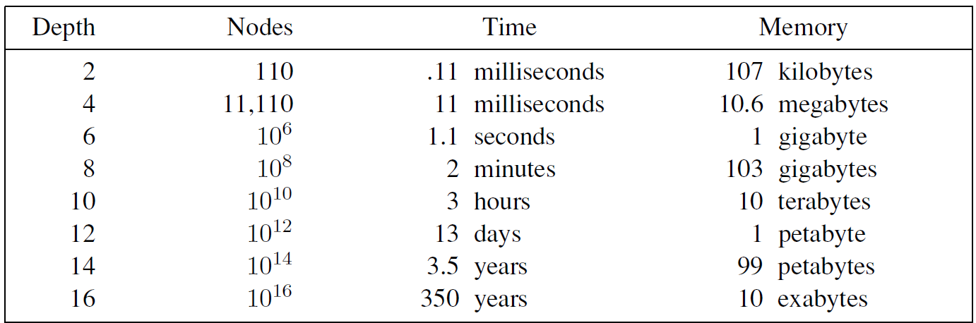
Breadth-first search
Time and memory requirements for breadth-first search
with branching factor b = 10
Assuming
1 million nodes can be generated per second
a node requires 1000 bytes of storage

Slide 37

Depth-first Search (DFS)

Slide 38
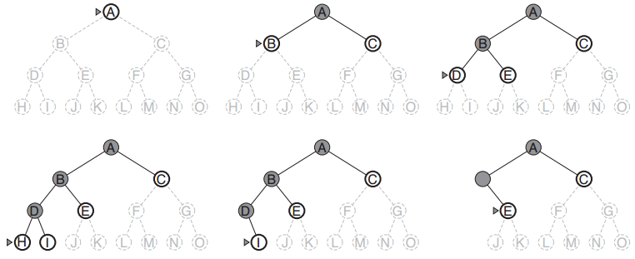
Depth-first search
always expands the deepest node in current frontier of search tree
Search proceeds immediately to the deepest level of search tree, where nodes have no successors
As those nodes are expanded, they are dropped from the frontier, so then search “backs up” to next deepest node that still has unexplored successors
The marker indicates the node that is expanded next

Slide 39
Depth-first search
Expand the deepest unexpanded node until you fail or find a solution node
Deepest = LIFO queue (of the frontier) sorted by the depth of nodes
Most recently generated node is the deepest unexpanded node because it is one deeper than its parent which, in turn, was the deepest unexpanded node when it was selected

Slide 40
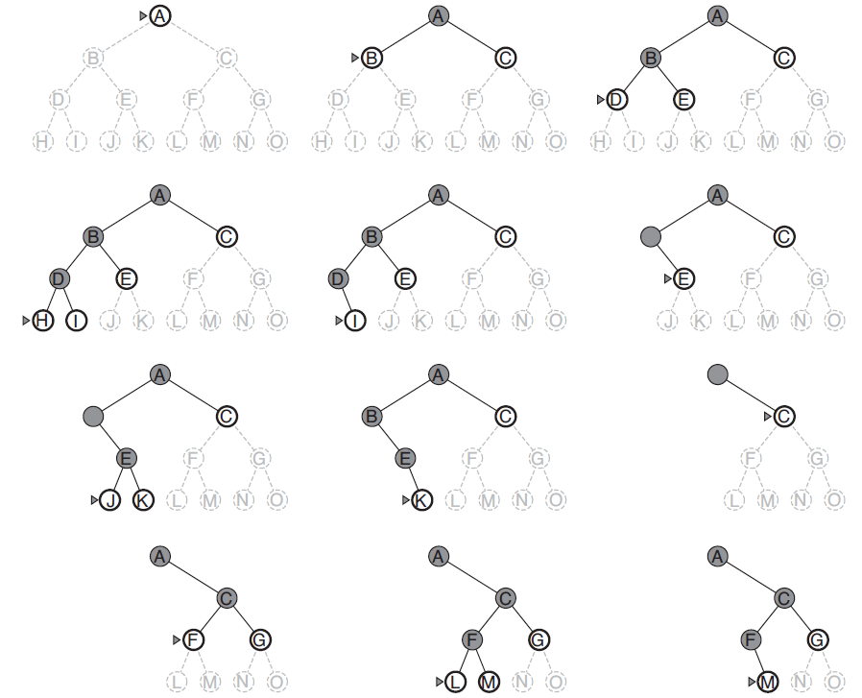
Depth-first search
Explored nodes with no descendants in frontier are removed from memory

Slide 41
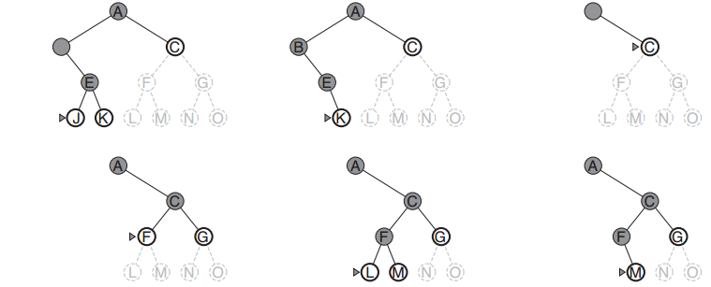
Depth-first search
Complete = ?
tree-search version is not complete; e.g., algorithm will follow the Arad–Sibiu–Arad–Sibiu loop forever
graph-search version, which avoids repeated states and redundant paths, is complete in finite state spaces

Slide 42
Depth-first search
Complete = No (if tree-search) - Yes (if graph-search)
(Cost)Optimal = No
will explore the entire left subtree even if node C is a goal node

Slide 43
Depth-first search
Complete = No (if tree-search) - Yes (if graph-search)
(Cost)Optimal = No
Time = O(b^{m})
m maximum depth of any node
bad if m is much larger than d
If solutions are dense it may be much faster than breadth-first
b
1 node
…
b nodes
b² nodes
m
Number of nodes in entire tree:
1 + b + b² + …. b^{m} = O(b^{m})
b^{m} nodes

Slide 44
Depth-first search
Complete = No (if tree-search) - Yes (if graph-search)
(Cost)Optimal = No
Time = O(b^{m})
Space = O(bm)
When a node has been expanded, it can be removed from memory once all its descendants are explored
b
1 node
…
b nodes
b² nodes
m
b nodes
Number of nodes in entire tree:
1 + b + b² + …. b^{m} = O(b^{m})
b nodes
b^{m} nodes

Slide 45
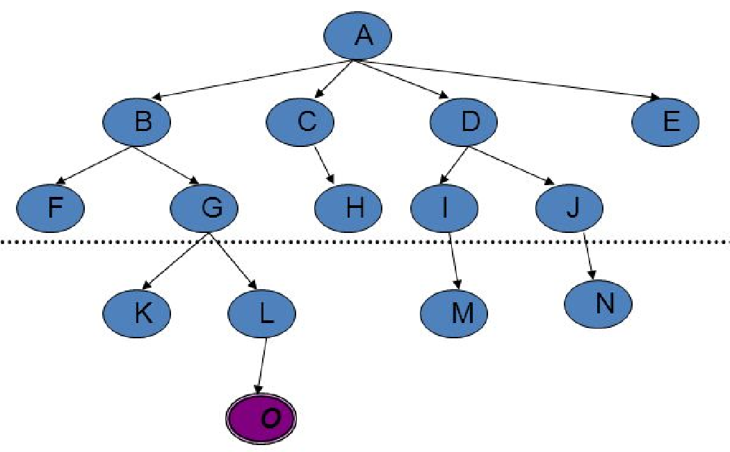
Depth-limited search
failure of depth-first search in infinite state spaces can be alleviated by supplying depth-first search with a predetermined depth limit L
nodes at depth L are treated as if they have no successors
depth limit solves the infinite-path problem
it may lead to incompleteness if we choose L < d; e.g., shallowest goal (d=4) is beyond the depth limit (L=2)
non-optimal if we choose L > d
time complexity O(b^{L})
space complexity O(bL)
Depth-first search: as a special case of depth-limited search with L = ∞.

Slide 46
Depth-limited search
Sometimes, depth limits can be based on knowledge of problem
e.g., on map of Romania there are 20 cities → we know that if there is a solution, it must be of length 19 at the longest → so L = 19 is a possible choice
For many problems, however, we will not know a good depth limit until we have solved the problem

Slide 47
Iterative deepening search
Idea: get DFS’s space advantage with BFS’s time / shallow-solution advantages
Run a DFS with depth limit 1. If no solution…
Run a DFS with depth limit 2. If no solution…
Run a DFS with depth limit 3. …..
Isn’t that wastefully redundant?
Generally most work happens in the lowest level searched, so not so bad!
b
…

Slide 48
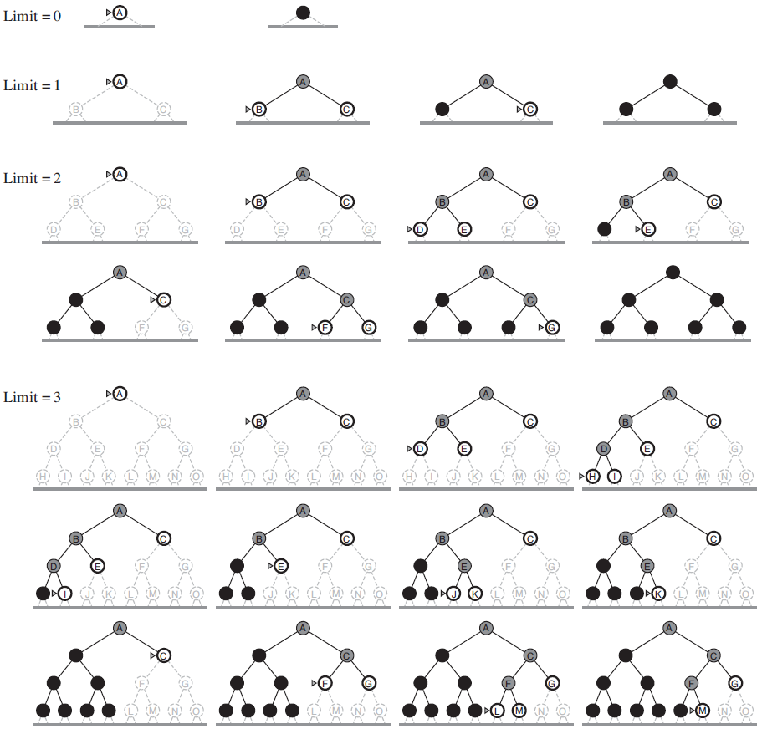
Iterative deepening search
a general strategy that finds the best depth limit
gradually increasing the limit: first 0, then 1, then 2, and so on, until a goal is found (when depth limit reaches d, depth of shallowest goal node)
Iterative deepening search on a binary search tree, where
solution is found on 4th iteration

Slide 49
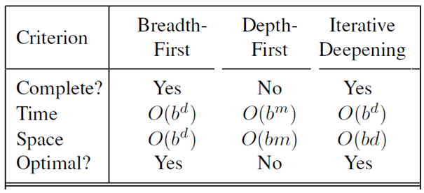
Iterative deepening search
Iterative deepening combines the benefits of DFS (space) and BFS (time)
Like DFS, its memory requirements are modest: O(bd)
Like BFS, it is complete when the branching factor is finite and optimal when the path cost is a non-decreasing function of depth of the node (everything on the frontier is at higher cost)

Slide 50

Uniform-Cost Search (UCS)

Slide 51
Uniform-Cost search
When all step costs are equal, breadth-first search is optimal because it always expands shallowest unexpanded node
Uniform-cost search is optimal with any step-cost function
Instead of expanding shallowest node, it expands least-cost unexpanded node
storing frontier as a priority queue ordered by path cost
goal test is applied to a node when it is selected for expansion rather than when it is first generated (first goal node that is generated may be on a suboptimal path)
Equivalent to breadth-first if step costs all equal
b
…

Slide 52
Uniform-Cost search
Animation of the Uniform-Cost Algorithm
https://www.dropbox.com/s/xoy86uf38y52htf/Animation%20of%20the%20Uniform%20Cost%20Algorithm.mp4?dl=0

Slide 53
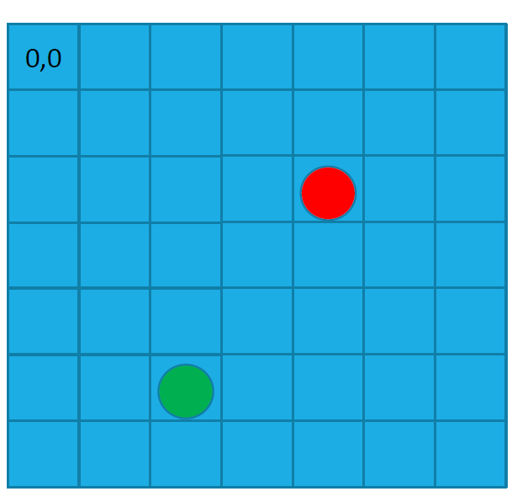
Games & AI Search
Need more sophisticated rules?
…Need proper planning search & planning!

Slide 54

BFS

Slide 55
BFS

Slide 56
DFS

Slide 57
BFS with Deep/Shallow Water
Notes:
Let students guess which one of the three it is. (This is BFS.)

Slide 58
DFS with Deep/Shallow Water
Notes:
Let students guess which one of the three it is. (This is DFS.)

Slide 59
UCS with Deep/Shallow Water
Notes:
Let students guess which one of the three it is. (This is UCS.)

Slide 60
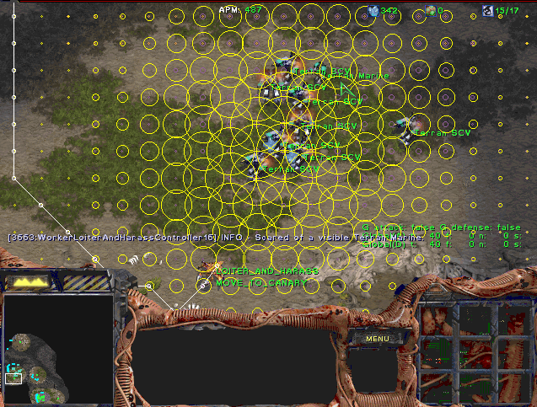
Games & AI Search

Slide 61
Games & AI Search
Aliens vs. Predator
https://www.dropbox.com/s/uv57fyc0up01f6d/Aliens%20vs%20Predator.mp4?dl=0

Slide 62
a
G
b
c
e
d
e
d
f
f
S
h
p
r
q
r
S
s
s → d
s → e
s → p
s → d → b
s → d → c
s → d → e
s → d → e → h
s → d → e → r
s → d → e → r → f
s → d → e → r → f → c
s → d → e → r → f → G
d
e
p
b
c
e
h
r
q
a
a
h
r
p
q
f
p
q
f
q
c
G
q
c
G
a
a

Slide 63
Depth-first Search
Strategy: expand a deepest node first
Implementation: Frontier is a LIFO stack
a
G
a
c
b
c
b
e
d
e
d
f
f
S
h
h
p
p
r
q
r
q
S
d
e
p
b
c
e
h
r
q
a
a
h
r
p
q
f
p
q
f
q
c
G
q
c
G
a
a

Slide 64
Breadth-first Search
Strategy: expand a shallowest node first
Implementation: Frontier is a FIFO queue
a
G
b
c
d
e
f
S
h
p
q
r
S
d
e
p
Search
Tiers
q
b
c
e
h
r
a
a
h
r
p
q
f
p
q
f
q
c
G
q
c
G
a
a

Slide 65
Uniform-cost Search
2
G
Strategy: expand a cheapest node first:
Frontier is a priority queue (priority: cumulative cost)
a
b
1
8
c
2
2
3
d
e
f
9
8
2
S
h
1
1
p
q
r
15
0
S
d
3
e
9
p
1
b
4
e
5
h
17
r
11
q
16
c
11
Cost contours
a
6
a
h
13
r
7
p
q
f
p
q
f
8
q
c
G
q
c
a
11
G
10
a
We have explored every possible path with the cost of 10 or lower!

Slide 66

Informed Search
A search strategy that uses problem-specific knowledge beyond the definition of the problem itself
Greedy best-first search
A* search

Slide 67



Search Heuristics
A heuristic is:
A function that estimates how close a state is to a goal
Designed for a particular search problem
Examples: Manhattan distance, Euclidean distance for path-finding problems
10
5
11.2

Slide 68
Example: Heuristic Function
h(x)

Slide 69

Greedy Search

Slide 70
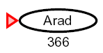

Greedy Search
Evaluation function f(n) = h(n) will be a “h”euristic
h(n) (heuristic) = Estimate of the cost from “n” to the goal node
For example: h_SLD(n) = Straight-Line-Distance from n to Bucharest
Expand the node that seems closest…
What can go wrong?

Slide 71
Greedy Search
b
Strategy: expand a node that you think is closest to a goal state
Heuristic: estimate of distance to nearest goal for each state
A common case:
Best-first may take you along the wrong path
Worst-case: like a badly-guided DFS
…
b
…

Slide 72
Greedy Search

Slide 73
Greedy Search

Slide 74
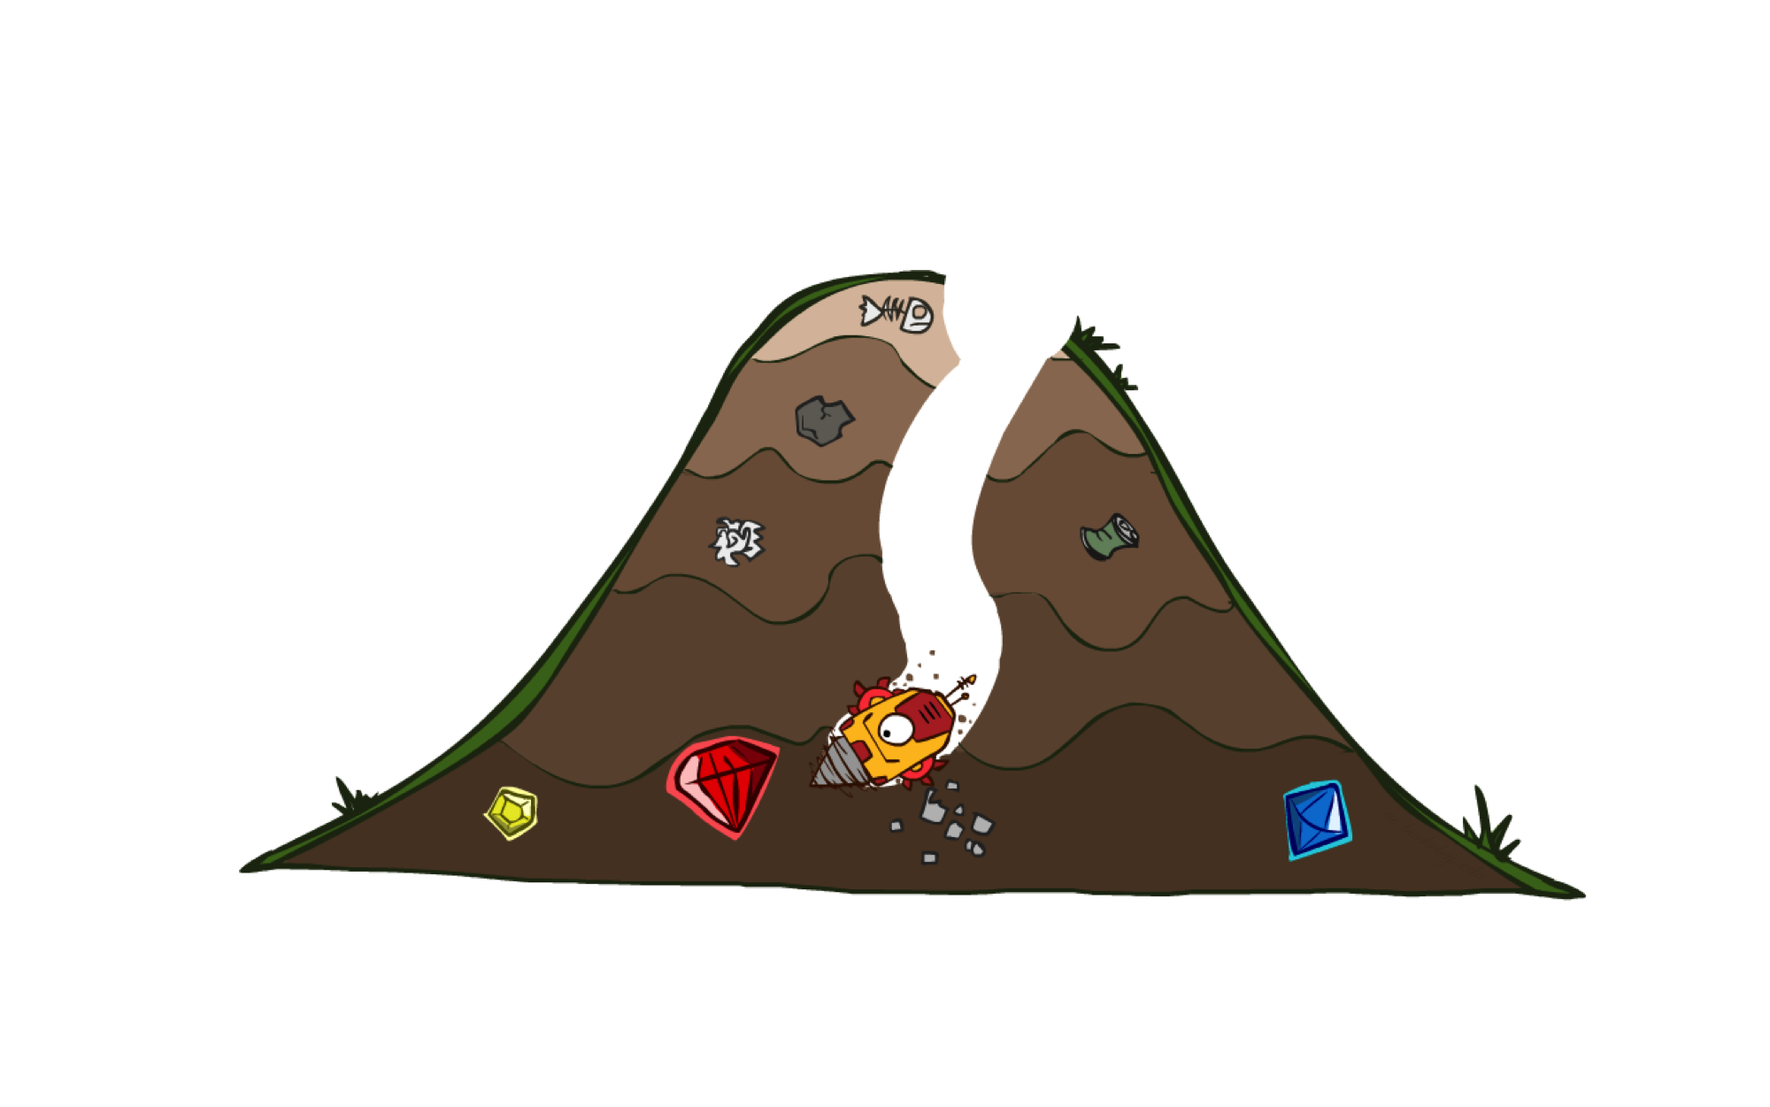
A* Search

Slide 75



A* Search
UCS
Greedy
A*

Slide 76
A* Search
Uniform-cost orders by path cost, or backward cost g(n)
Greedy orders by goal proximity, or forward cost h(n)
A* Search orders by the sum: f(n) = g(n) + h(n)
g = 0 h=6
S
g = 1 h=5
a
g = 2 h=6
g = 4 h=2
g = 9 h=1
b
d
e
g = 3 h=7
g = 6 h=0
g = 10 h=2
c
G
d
8
g = 12 h=0
G
e
h=1
1
1
3
2
S
a
d
G
h=6
1
h=5
h=2
h=0
1
c
b
h=7
h=6

Slide 77
A* Search
Idea: avoid expanding paths that are already expensive
Evaluation function f(n) = g(n) + h(n)
g(n) = cost so far to reach node n
h(n) = estimated cost of cheapest path from n to goal
f(n) = estimated total cost of cheapest path through n to goal

Slide 78
A* Search
Should we apply goal test when we generate a node?
No: only when we select node for expansion
g = 2
h = 2
2
A
2
g = 4
h = 0
S
g = 0
h = 3
G
g = 5
h = 0
2
B
3
g = 2
h = 1

Slide 79
Admissible Heuristics
g = 1
h = 6
1
A
3
g = 4
h = 0
S
g = 0
h = 7
G
g = 5
h = 0
What went wrong?
Estimated cost > actual cost!
We need estimates to be less than actual costs!

Slide 80


Admissible Heuristics
Inadmissible (pessimistic) heuristics break optimality by trapping good plans on the frontier (fringe)
Admissible (optimistic) heuristics slow down bad plans but never outweigh true costs

Slide 81


Admissible Heuristics
A heuristic h is admissible (optimistic) if:
where is the true cost to a nearest goal
So an admissible heuristic never overestimates the cost to reach the goal; it is optimistic.
Example: h_SLD(n) (never overestimates the actual road distance)
Coming up with admissible heuristics is most of what’s involved in using A* in practice.

Slide 82
Consistent Heuristics
A heuristic is consistent if:
for every node n, every successor n’ of n was generated by any action so that:
h(n) ≤ cost(n to n’) + h(n’)
f(n') = g(n') + h(n')
= g(n) + cost(n to n’) + h(n') ≥ g(n) + h(n)
f(n') ≥ f(n)
∴ f(n) is non-decreasing along any path.
n
cost(n to n’)
1
n’
h(n)
3
h(n’)
G

Slide 83

Optimality of A* Tree Search
Theorem:
If h(n) is admissible, A* using TREE-SEARCH is optimal
If h(n) is consistent, A* using GRAPH-SEARCH is optimal

Slide 84
A* Search
UCS Greedy A*

Slide 85

Recommended reading
Stuart Russell, Peter Norvig: Artificial Intelligence A Modern Approach
Chapter 3

Slide 86

AI Lecture 1: Module overview and introduction to sessions

